Slide 1
Process Synchronization

Slide 2
Concurrent Processing
The concurrent processing is done by the processes which are cooperative in nature.
They information exchanged between them is done either through shared memory concept of message passing
Concurrent access to shared data may result in data inconsistency.

Slide 3
Race Condition
Where several processes access and manipulate the same data concurrently and the outcome of the execution depends on the particular order in which the access takes place, is called a race condition.

Slide 4
The Critical-Section Problem
Each process running in the system has a segment of code, called a critical section, in which the process may be changing common variables, updating a table, writing a file, and so on.
When one process is executing in its critical section then no other process is allowed to enter in its critical section.

Slide 5
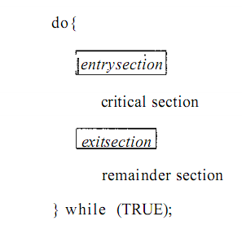
The Critical-Section Problem

Slide 6
The Critical-Section Problem
The solution to critical section problem must satisfy the following three requirements:
  Mutual exclusion
  Progress
  Bounded Waiting

Slide 7
Solutions to Critical Section Problem
Solutions to CS can be
  Software solution
  Hardware solution

Slide 8
Using flag variable two process Solution for critical section Problem
P0
While(1)
{
Flag [0]=T
While(flag[1]);
Critical section
Flag[0]=F
RS
}
P1
While(1)
{
Flag[1]=T
While(flag[0]);
Critical section
Flag[1]=F;
RS
}

Slide 9
Software-Based Solution
Peterson’s Solution
  Peterson's solution is restricted to two processes that alternate execution between their critical sections and remainder sections. The processes are numbered P0 and P1.
  Peterson's solution requires two data items to be shared between the two processes:
    int turn;
    boolean flag [2] ;

Slide 10
Software-Based Solution
int Flag[2]; int turn; Flag[0]=F and Flag[1]=F
P0 P1
do do
{ {
Flag[0]=T; Flag[1]=T;
turn=1; turn=0;
while(flag[1]==T && turn==1) while(flag[0]==T &&turn==0)
{ {
do nothing do nothing
} }
<critical section> <critical section>
Flag[0]=F; Flag[1]=F;
<remainder section> <remainder section>
} }
while(1); while(1);

Slide 11
Semaphores
It is a synchronization tool.
A semaphore S is an integer variable that, apart from initialization, is accessed only through two standard atomic operations: wait () and signal ().
Wait()- to test – also called P(proberen)semaphore
Signal()- to increment – also called V(verhogen) semaphore

Slide 12

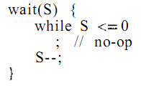
Semaphores
Definition for wait() and signal()

Slide 13
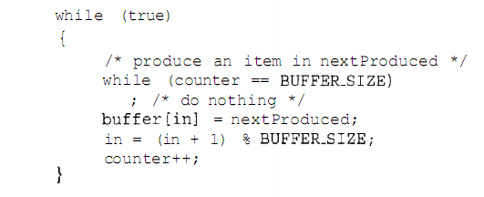
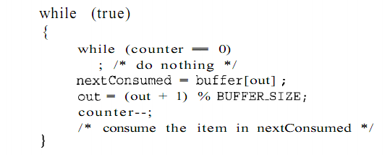
Producer-Consumer Problem

Slide 14
Producer Consumer Problem
Void Producer()
{
While(T)
{
Produce()
wait(E)
wait(s)
Append()
Signal(S)
Signal(F)
}
}
Void consumer()
{
while(T)
{
Wait(F)
Wait(S)
Take()
Signal(S)
Signal(E)
Use()
}
}

Slide 15
Reader /Writer Problem
For reader
Wait(mutux)
Readcount++
if(readcount==1)
wait(wrt)
Signal(mutux)
read operation
wait(Mutux)
readcount--;
if(readcount==0)
signal (wrt)
signal(mutux)
For write
Wait(wrt)
write operation
Signal(wrt)

Slide 16
A counting semaphore was initialized to 10. The 6P(wait) operation and 4V (signal) were completed on this semaphore resulting value of the semaphore is__________

Slide 17
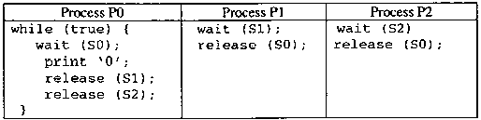
The following program consists of 3 concurrent processes and 3 binary semaphores.The semaphores are initialized as S0 = 1, S1 = 0, S2 = 0.
How many times will process P0 print ‘0’?
(A) At least twice
(B) Exactly twice
(C) Exactly thrice
(D) Exactly once

Slide 18
Hardware Solutions
Many systems provide hardware support for critical section code
Uniprocessors – could disable interrupts
  Currently running code would execute without preemption
  Generally too inefficient on multiprocessor systems
    Operating systems using this not broadly scalable
Modern machines provide special atomic hardware instructions
    Atomic = non-interruptable
  Either test memory word and set value
  Or swap contents of two memory words

Slide 19
Solution using Fetch and Increment
int nextTicket = 0, serving = 0;
mutexbegin()
{
int myTicket;
myTicket = FAI(nextTicket);
while (myTicket != serving) ;
}
mutexend()
{
++serving;
}
Correctness proof:
Mutual exclusion: contradiction.
Assumption: no process ``plays'' with control variables.
Progress: by inspection, there's no involvement from processes operating outside their CSs.
Bounded waiting: myTicket at most n more than serving

Slide 20
TestAndSet
boolean TestAndSet (boolean *target)
{
boolean rv = *target;
*target = TRUE;
return rv:
}

Slide 21
Solution using TestAndSet
Shared Boolean variable lock., initialized to false.
Solution:
while (true) {
while ( TestAndSet (&lock ))
; /* do nothing
// critical section
lock = FALSE;
// remainder section
}

Slide 22
Monitors in Process Synchronization
he monitor is one of the ways to achieve Process synchronization. The monitor is supported by programming languages to achieve m
It is the collection of condition variables and procedures combined together in a special kind of module or a package.
The processes running outside the monitor can’t access the internal variable of the monitor but can call procedures of the monitor.
Only one process at a time can execute code inside monitors.

Slide 23
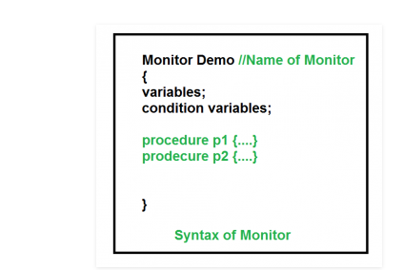
Monitors in Process Synchronization

Slide 24
condition x, y; // Declaring variable
Wait operation
x.wait() : Process performing wait operation on any condition variable are suspended.
The suspended processes are placed in block queue of that condition variable.
Note: Each condition variable has its unique block queue.
Signal operation
x.signal(): When a process performs signal operation on condition variable,
one of the blocked processes is given chance.
If (x block queue empty) // Ignore signal else
// Resume a process from block queue.
Else
.. Resume a process from block queue

Slide 25
The Dining philosophers problem
“Five philosophers sit around a table, which is set with 5 plates (one for each philosopher), 5 chopsticks, and a bowl of rice. Each philosopher alternately thinks and eats. To eat, he needs the two chopsticks next to his plate. When finished eating, he puts the chopsticks back on the table, and continues thinking.”
Philosophers are processes, and chopsticks are resources.

Slide 26
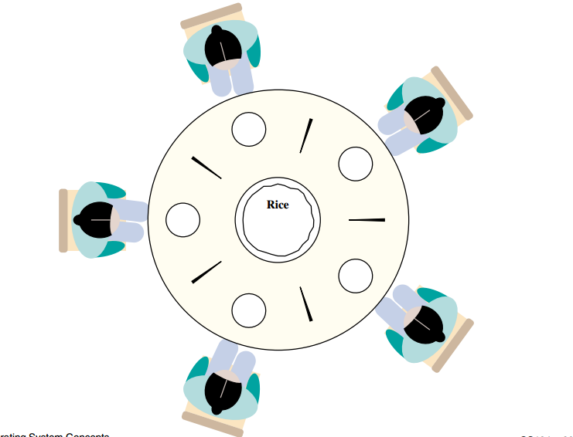
The Dining philosophers problem

Slide 27
The Dining philosophers problem
Methods:
– start_eating(i): if chopsticks[i] < 2, then philosopher i must wait; otherwise decrement the chopstick counts, and eat
– stop_eating(i): increments the neighboring chopstickscounts

Slide 28
Problems with dining philosophers
The system may deadlock: if all 5 philosophers take up their left chopstick simultaneously, the system will halt (unless one of them puts one back)

Slide 29
Solution
One simple solution is to represent each chopstick with a semaphore.
A philosopher tries to grab a chopstick by executing a wait () operation on that semaphore; he releases his chopsticks by executing the signal() operation on the appropriate semaphores.

Slide 30
process P[i]
while true do
{ THINK;
PICKUP(CHOPSTICK[i], CHOPSTICK[i+1 mod 5]);
EAT;
PUTDOWN(CHOPSTICK[i], CHOPSTICK[i+1 mod 5]) }

